Slide 1
DESCRIPTIVE STATISTICS

Slide 2
The Workflow of Data
1.
A systematic workflow of data reduces the risk of making mistakes!
A workflow of data is a strategy to keep track of entering, cleaning, describing, and transforming data
A good workflow of data saves time, allows sharing the analysis and/or replicate the research
Haphazardly entering, cleaning, and analyzing bits of data is not a good strategy
Without a good workflow, the risk of having to duplicate work or even to lose the data entirely due to accidents increases
Create structure
Enter data
2.
3.
Clean data
Interviewer fraud
Suspicious response patterns
Data entry errors
Outliers
Missing Data
4.
Describe data
Transform data (optional)
5.
6.
Create a codebook

Slide 3
The Workflow of Data: Steps 1 to 4
1.
Create structure
2.
Enter data
Saves time and allows to share and/ or replicate the analysis and research
Save original dataset as a .zip file for small projects
Structure the subdirectories: e.g., data files, Syntax files, Output files, …..
Names of files and variable names&labels should be clear
Specialized software (e.g., epidata for paper-based interviews or Confirmit for (mobile) CATI
Enter data by hand in SPSS or Excel: Risk of making errors
Checks of consistency are very important
3.
Clean Data
4.
Describe Data
Check data for interviewer fraud
Check data for suspicious response patterns (straight-lining and inconsistencies)
Check data for entry errors
Check data for outliers
Check for missing data
Univariate analysis (e.g., mean, median or variance)
Bivariate analysis (e.g., crosstabs or correlations)

Slide 4
Outliers
Outliers are values situated far from all the other observations. There are three types:
Outliers due to data collection or entry errors
Exceptionally high or low values that are a part of reality
Combinations of values that are exceptionally rare
Detection of outliers occurs through descriptive statistics
Should we delete or retain outliers?
If they are data collection or entry errors: yes (or try to look up the correct values)
If they are not, retain and describe the impact of these outliers.

Slide 5
Describe Data
Describe Data
Univariate
Bivariate
Graphs & tables
Statistics
Graphs & tables
Statistics
Bar chart
Measures of centrality:
Mode
Median
Mean
Scatter plots
Covariance
Histogram
Crosstabs
Correlation
Box plot
Measures of dispersion:
Range
Interquartile range
Variance
Standard deviation
Pie chart
Frequency table

Slide 6
Univariate & Bivariate Statistics
Univariate
Bivariate
Covariance
Correlation (Pearson)
Scatter plots
Crosstabs (Contingency tables, Pivot tables)
Mean
Median
Range
Interquartile range
Variance
Standard deviation

Slide 7
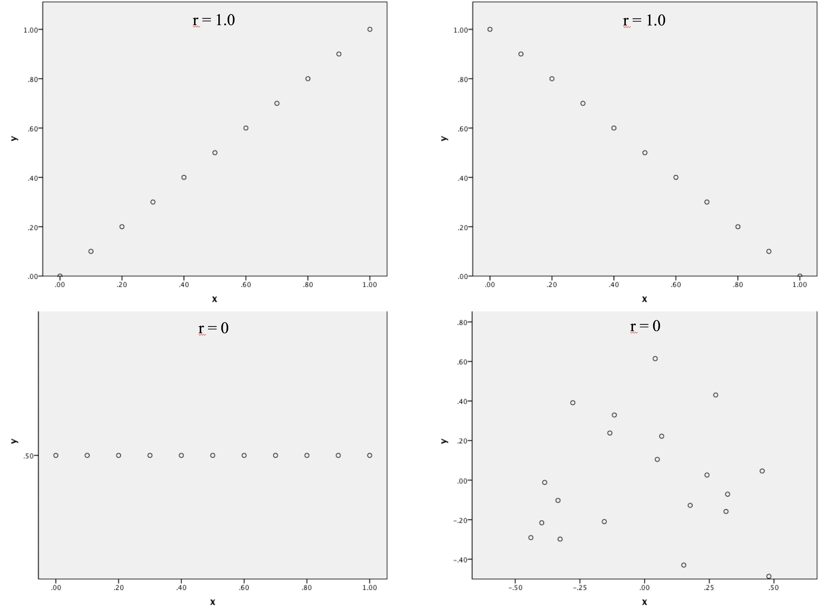
Univariate & Bivariate Statistics

Slide 8
Correlations
As a rule of thumb (Cohen 1988), an absolute correlation …
… below 0.30 indicates a weak relationship,
… between 0.30 and 0.49 indicates a moderate relationship, and
… above 0.49 indicates a strong relationship.
Spearman’s correlation coefficient is used for calculating
correlations between two variables that are both interval or ratio-scaled:
Spearman’s correlation coefficient and Kendall’s tau when at least one variable for determining the correlation is measured on an ordinal scale.
Contingency coefficient, Cramer’s V, and Phi for variables measured on a nominal scale. These statistical measures are used with crosstabs.

Slide 9
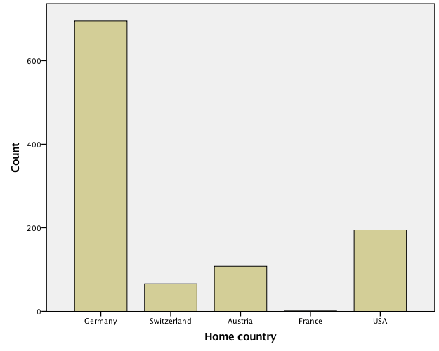
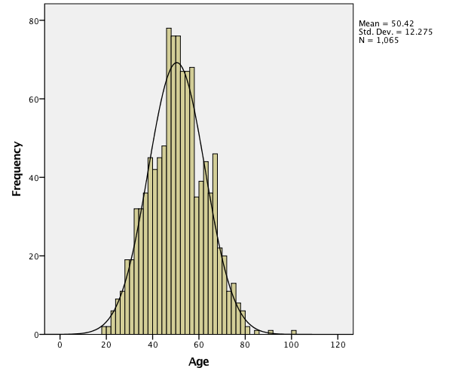
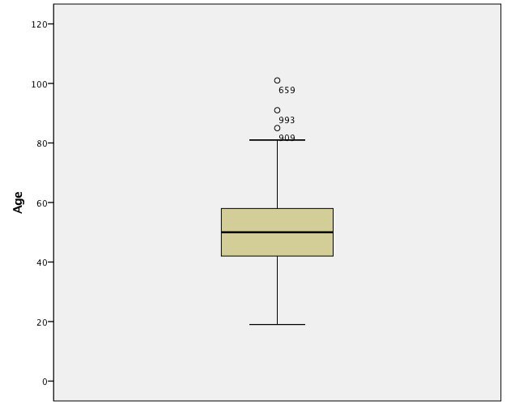
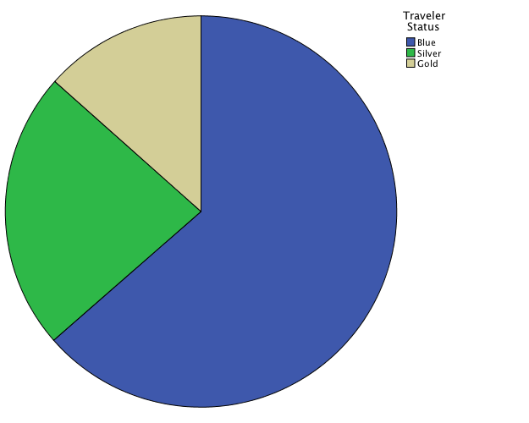
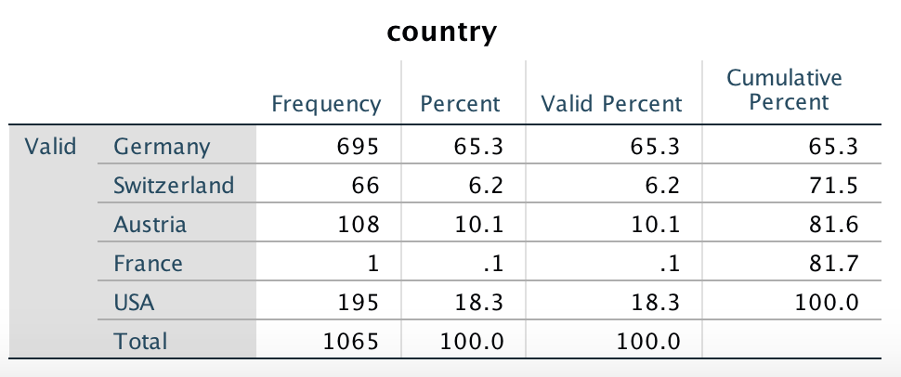
Univariate Graphs & Tables

Slide 10
Elements of the Box Plot

Slide 11
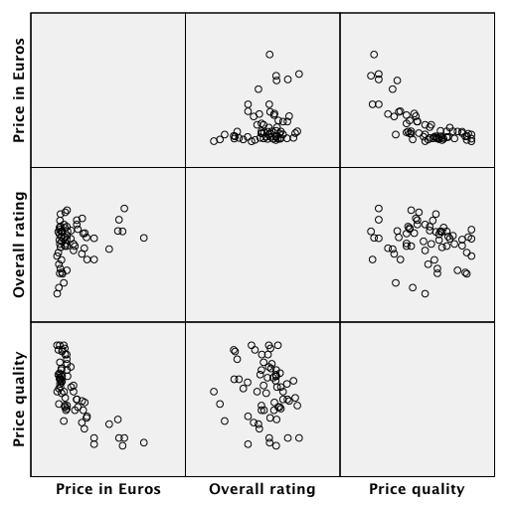
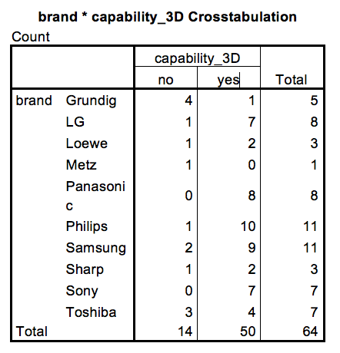
Bivariate Graphs & Tables
Scatter plot (matrix scatter)
Crosstab

Slide 12
The Workflow of Data: Steps 5 to 6
5.
Transform data
Transform data
Data transformations may be necessary for some analysis or for the interpretation of data
Variable respecification (e.g. coding the number of flights into low(=1), medium(2), and high (3) from the actual number of flights taken.
Dummy coding
Scale transformation ((z-)standardizing, log transformations, aggregation).
6.
Create a codebook
In large projects typically multiple persons are working on data analysis
A codebook contains essential details of the data
Content: Introduction, questionnaire(s), description of the variables, summary statistics, datasets

Slide 13
Introduction to SPSS

Slide 14

The Oddjob Airways case study
Oddjob Airways is a fictitious airline - with a real website: http://www.oddjobairways.com)
Oddjob Airways conducted a customer survey to improve its
customers’ satisfaction. Some details:
The company’s marketing department contacted all the customers who had flown with the airline during the last 12 months and were registered on the company website.
A total of 1065 customers completed the survey online.
Demographics: Age of customer, gender, language, home country
Flight behavior measures: flight class, timing of the last flight, purpose of flight, domestic/foreign flight, number of flights a year, traveller’s status (Blue, Silver, Gold).
Perception and satisfaction measures: recommendation, reputation, general satisfaction, overall, price/performance satisfaction, loyalty, commitment, traveler’s expectations, traveler’s satisfaction.

Slide 15
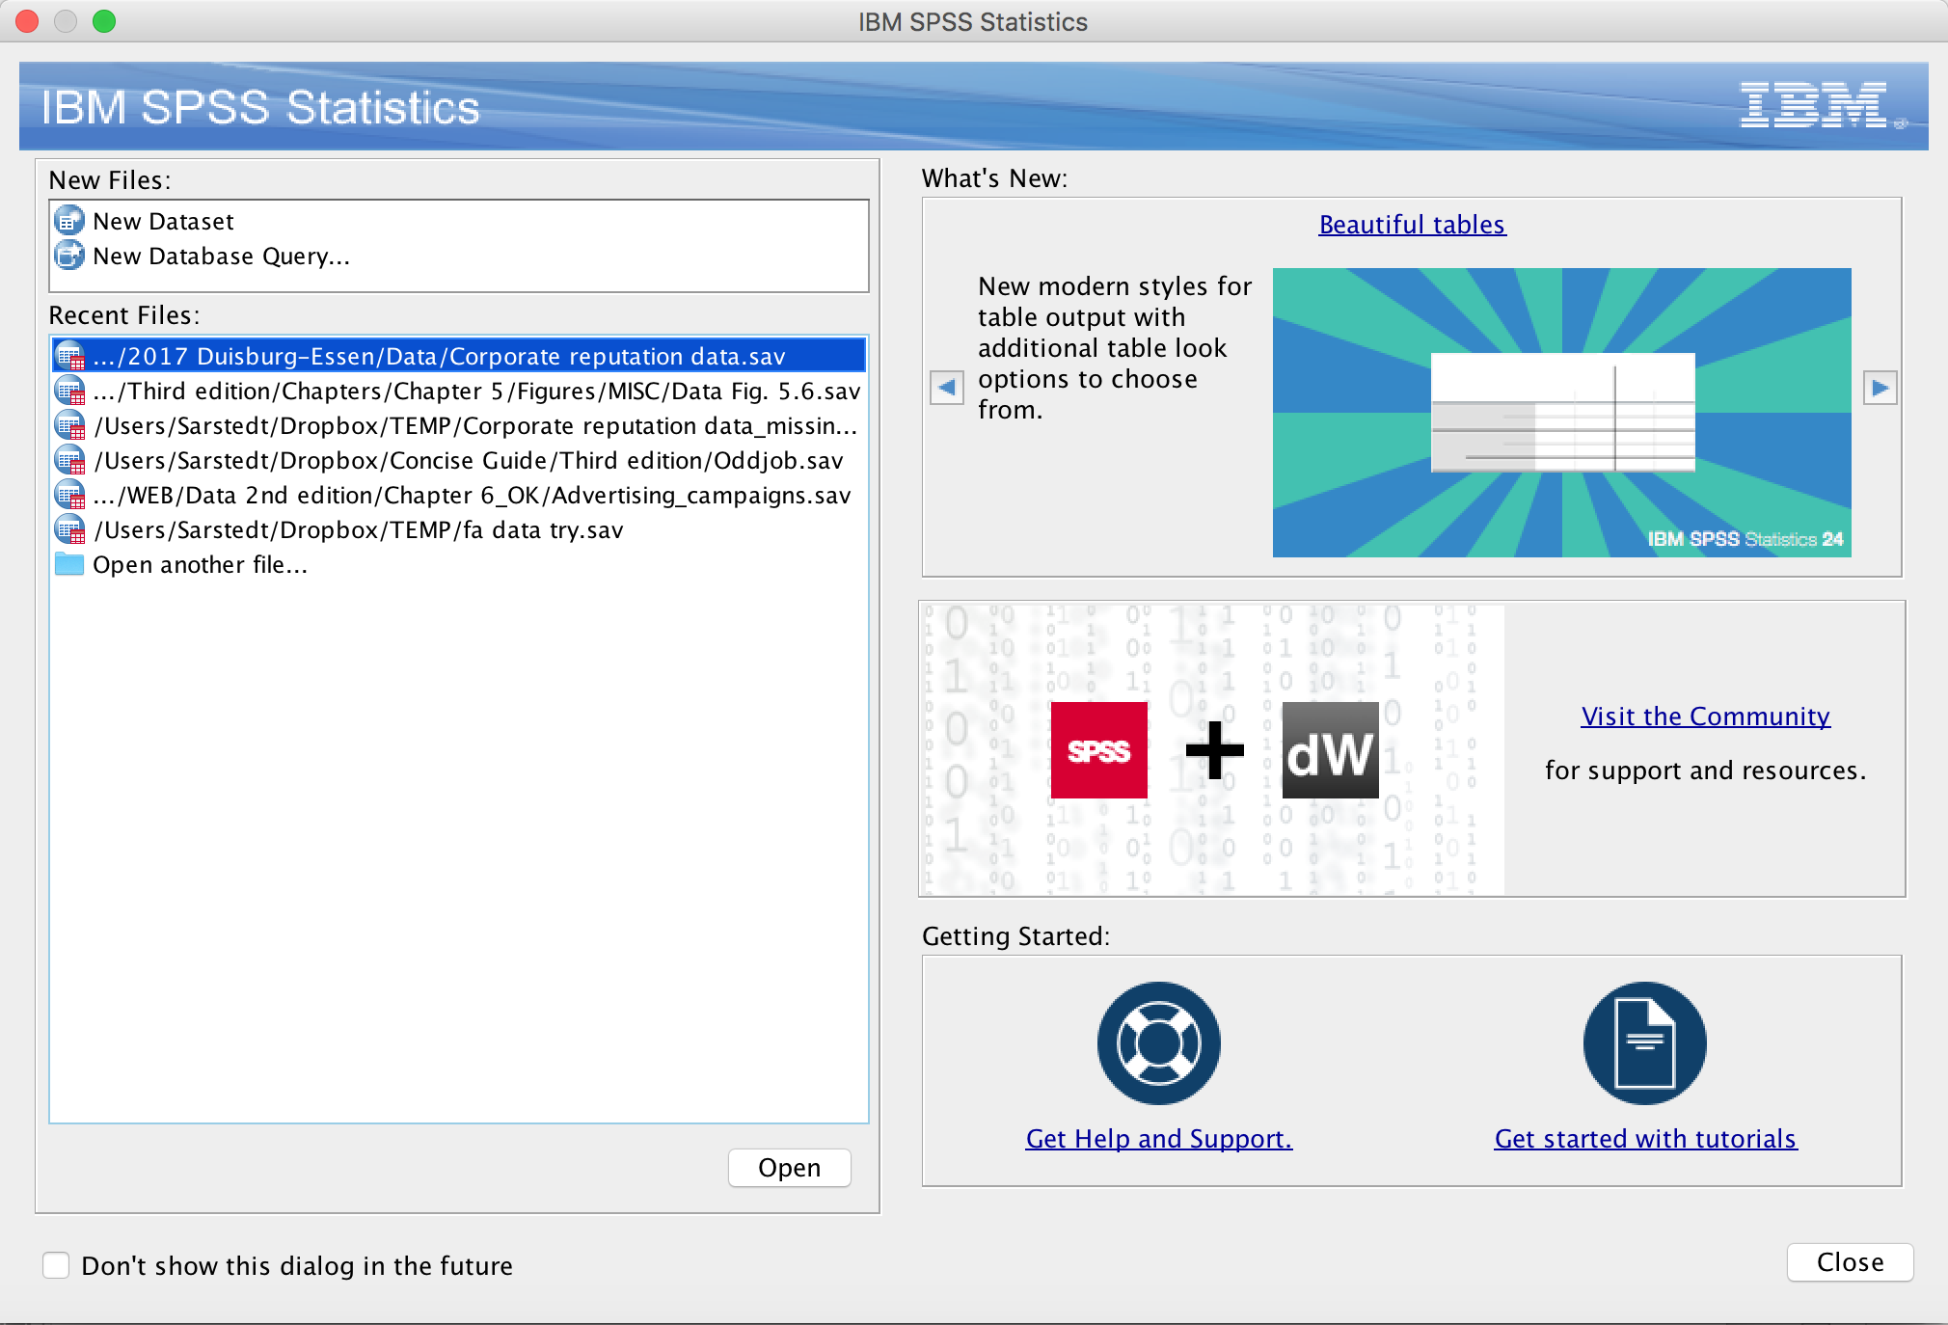
Introduction to SPSS: The Startup Screens
Open a recently used dataset
Open another dataset

Slide 16
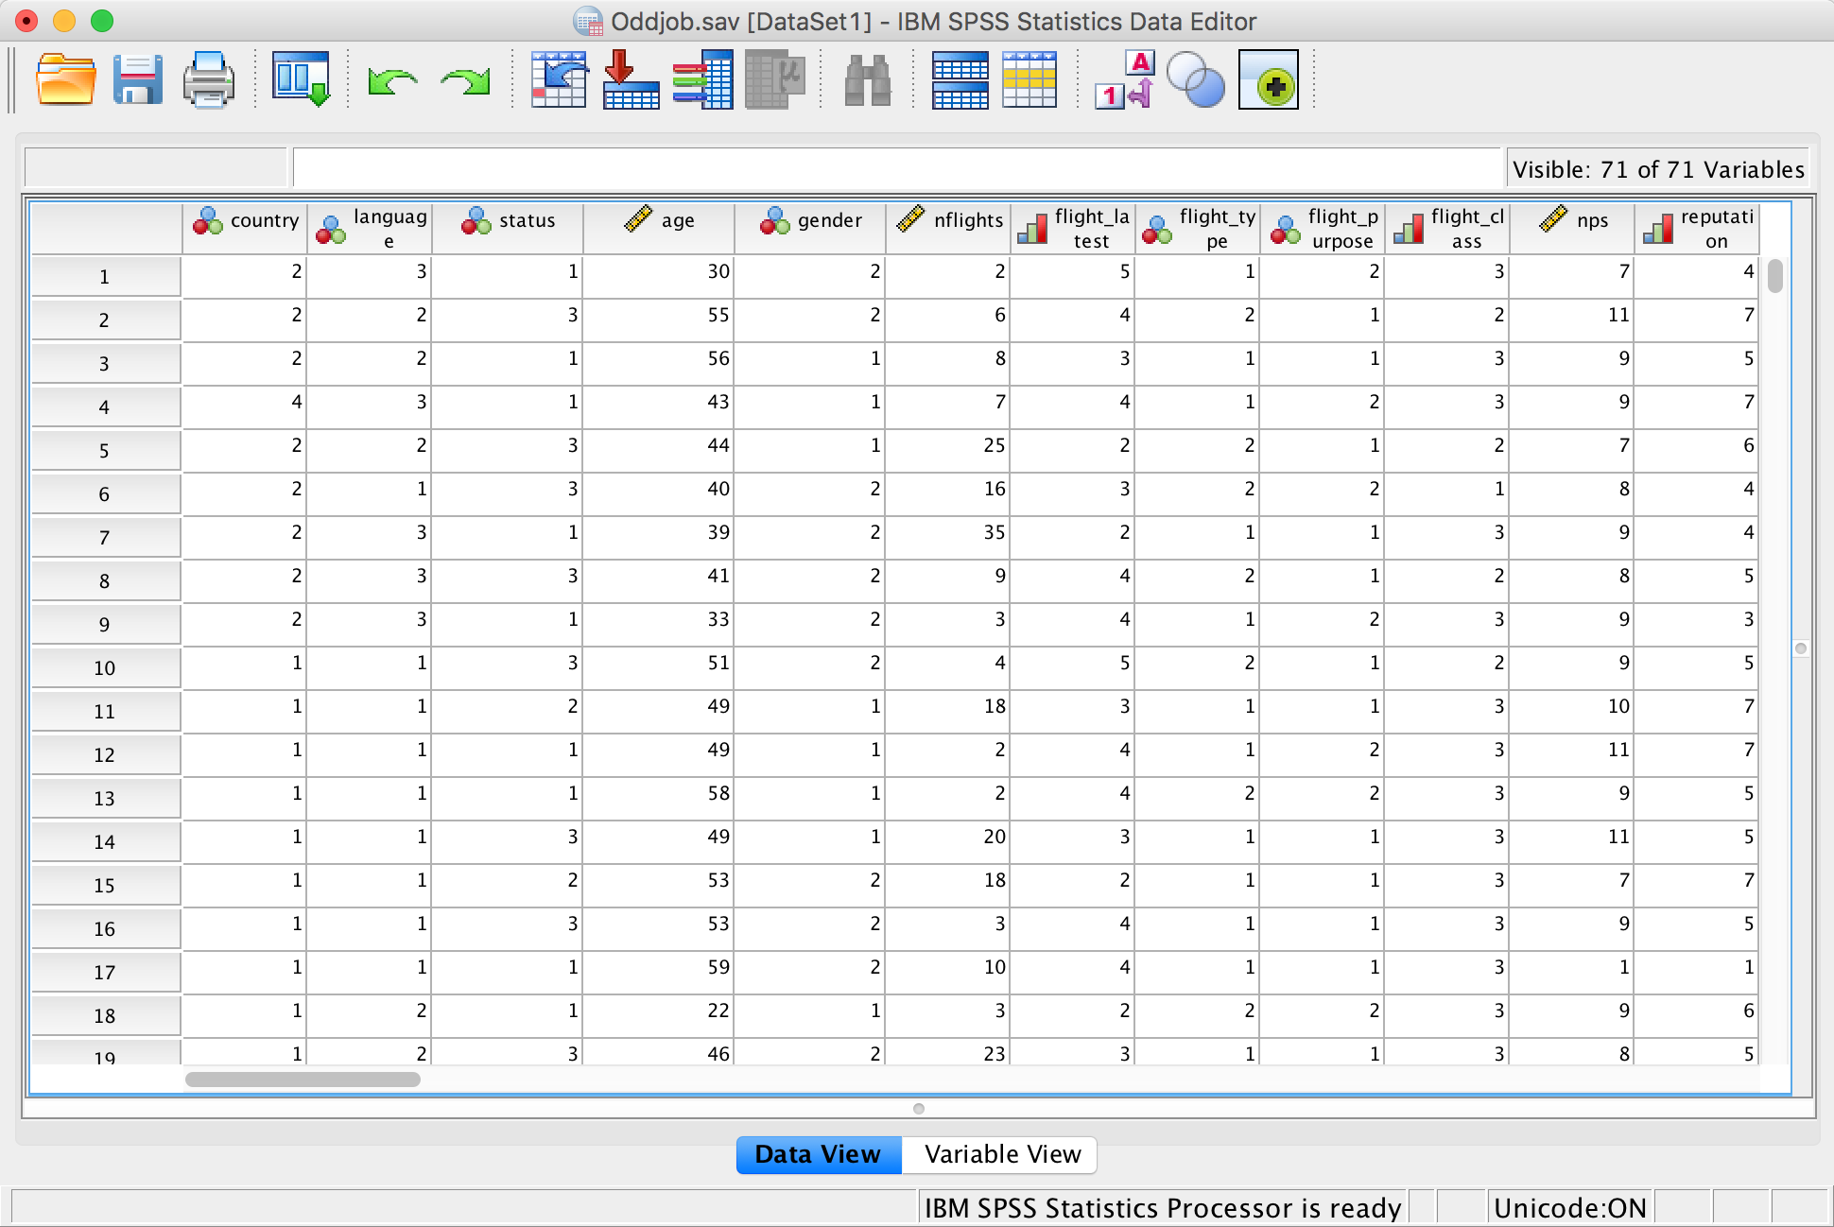
Introduction to SPSS: Data View
Variable
Case
Data view
Status information

Slide 17
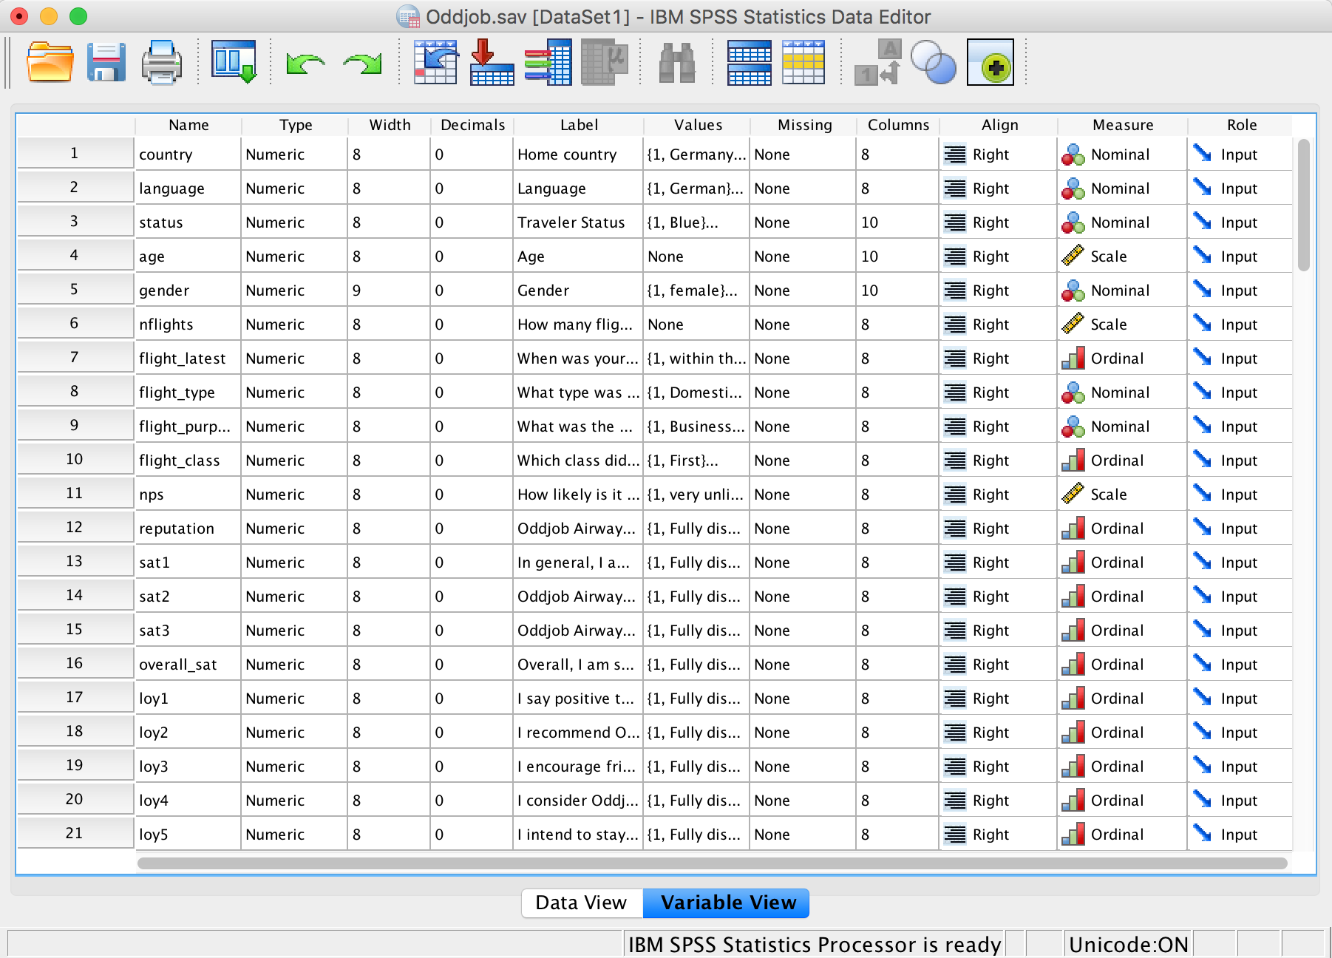
Introduction to SPSS: Variable View
Variable label
Type (numeric, string, dollar,…)
Value labels
User-defined missing values
Measurement level of variables
Name

Slide 18
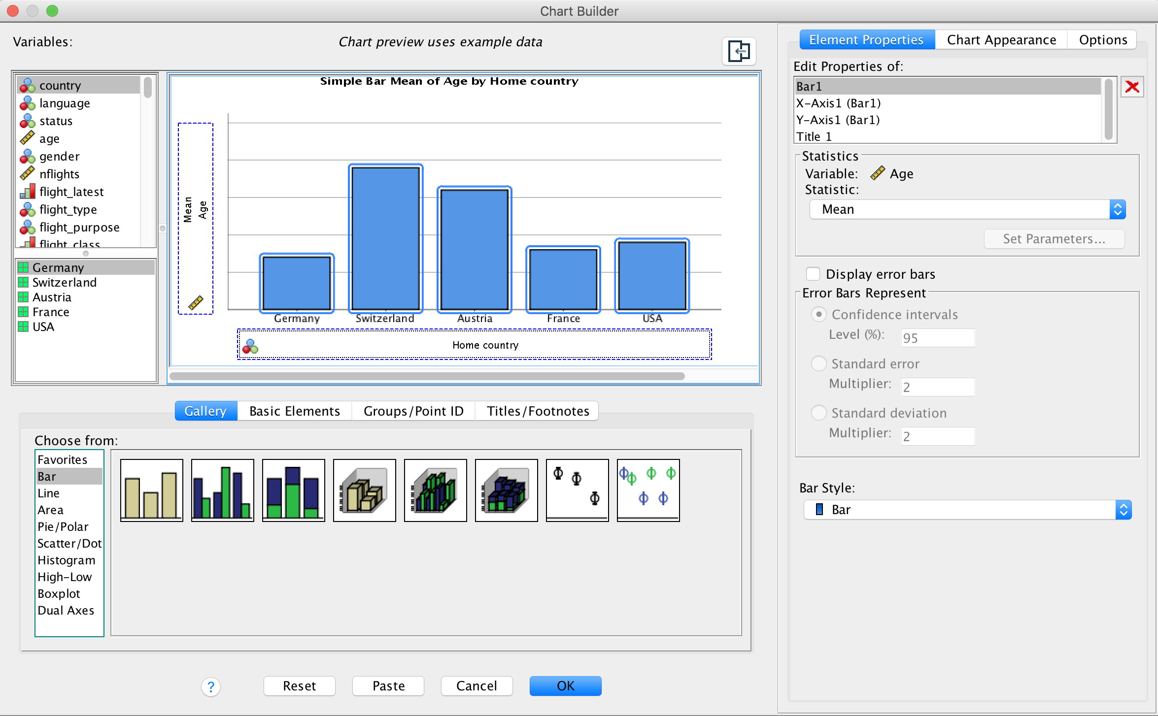
The Chart Builder

